Slide 1

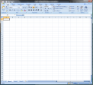
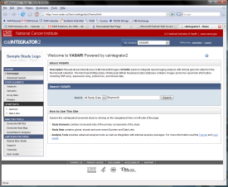
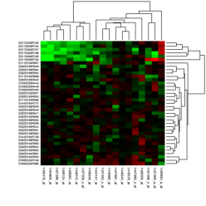

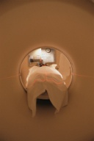
VASARI Study Scenario
CTODS
(Clinical Trials Object Data System)
OR
Clinical Data
Clinical Data Spreadsheet
caIntegrator2
Genomic Data
(mRNA expression, array CGH, etc.)
caArray
NCIA
(National Cancer Imaging Archive)
Image Annotation Spreadsheet
Patients in Study
Imaging Data

